Slide 1

CS 533 INTRO TO DATA SCIENCE
Michael Ekstrand

Slide 2
INTEGRATING DATA

Slide 3

Learning Outcomes
Combine two data sources
Identify the kinds of data useful to make a link
Photo by Sandy Millar on Unsplash

Slide 4


Data Integration
?

Slide 5
Types of Integration
Linking records – matching records in one set with another
Best case: we have a linking identifier shared between data sets.
Pooling records — taking records of the same kind from different sources
Convert each into common format, and stack!

Slide 6
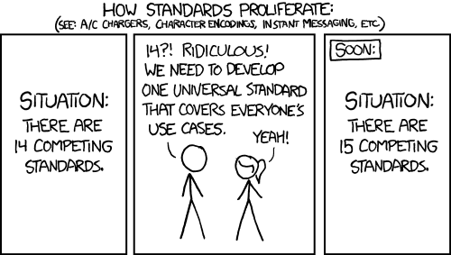
Identifiers?
identifiers
identifier
identifiers
identifiers
XKCD 927: Standards. © Randall Monroe. CC-BY-NC 2.5. Modified by me.

Slide 7
Example: Linking US Geopolitical Data
State name (unique, fine)
Postal code (2-character state abbreviation, unique, also fine)
FIPS code (Federal Information Processing Standard Series)
States and counties!
Withdrawn but still in use
Great when you have them!
ZIP codes
Legislative districts
Census tracts
Geographic position (lat, long) (ugggh)

Slide 8
Linking Challenges
Corrupt identifiers
Clean and correct them
Duplicate identifiers
Measure frequency of occurrence, try to measure impact
Missing identifiers
Find alternate linking strategies

Slide 9
Alternate linking strategies
Names?
Often not unique
Often take different forms
Locations?
Require complex geographic matching
Or address matching / normalization
Linking takes creativity and care

Slide 10
Recommended Approach
Take a conservative, incremental approach
Prefer identifiers
Minimize munging
Look at unlinked records, see what rules need to be added
Measure success of every linked step
Successfully-linked records
Unlinked records
Sometimes: use rate of different link strategies
Document and justify

Slide 11
Technical Pieces (for linking with Pandas)
Cleaning up individual columns
Series operations (esp. string ops!)
Merge data frames
pd.merge or pd.DataFrame.join (for linking records)

Slide 12
Pooling Records
Convert into common structure
Stack on top of each other
Sometimes: de-duplicate
Usually good to keep a field identifying record source.
pd.concat is your friend

Slide 13

Wrapping Up
We often need to combine data from multiple sources; sometimes linking, sometimes pooling.
Linking identifiers make this easy (sometimes).
We don’t always have them.
Photo by Joshua Hoehne on Unsplash

